Slide 1
Title: Customer Segmentation for Nigerian E-Commerce Retailer
Subtitle: CSC 63101: Data Mining and Business Intelligence (Question 2)
Aijuka Josbert
2023-B071-20758

Slide 2
Objectives
Scenario: A Nigerian retail company wants to improve marketing
through targeted segmentation.
Objective:
Preprocess raw sales data.
Analyze customer behavior trends.
Engineer features (Loyalty & Recency).
Apply K-Means Clustering to group customers.
Develop an interactive Dashboard for recommendations.
Tools Used: Python Notebook& Power BI.

Slide 3
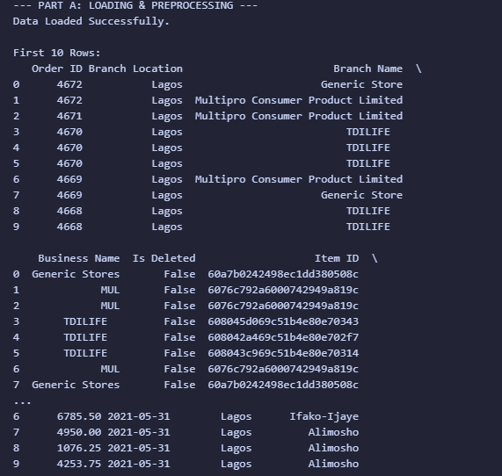
Part A - Data Loading & Preprocessing
Data Preprocessing
Steps Taken:
  Loaded dataset and converted Dates.
  Removed duplicates and missing values.
  Aggregated data to Customer Level (grouped by Business Name).

Slide 4
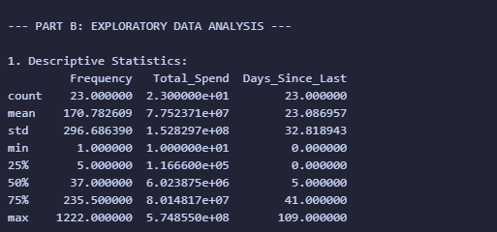
Part B - Descriptive Statistics
Analysis: Summary of key variables (Frequency, Total Spend, Dayss-since_last).
Interpretation:
Example: "The data shows high variance in Total Spend, indicating a mix of
wholesale and retail buyers.

Slide 5
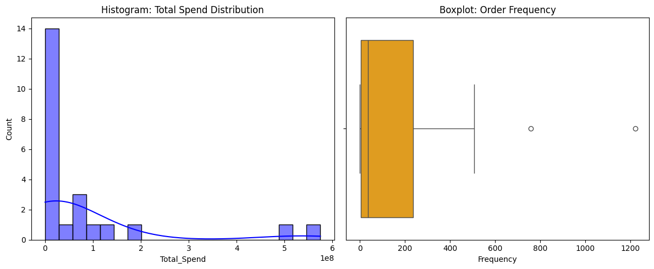
Part B - Distribution Analysis
Visuals: Understanding data spread and outliers.
Observation: The data is right-skewed; most customers buy infrequently, but a few "whales" buy very often.
Notes:
Histogram: Total Spend Distribution (Left Graph)This histogram displays how customer spending is distributed across your e-commerce platform:High concentration on the left: Most customers (around 14) spend very little (close to 0), indicating a large base of low-value customersLong right tail: A few customers spend significantly more (up to ~1e8, which is 100 million in your currency)KDE curve (purple line): Shows the probability density, confirming the right-skewed distributionInterpretation: This is typical for e-commerce - you have many small buyers and a few "whale" customers who contribute disproportionately to revenueBoxplot: Order Frequency (Right Graph)This boxplot shows the distribution of how often customers place orders:Box (orange): Represents the interquartile range (IQR) where 50% of customers fallMost customers order between ~100-800 timesMedian (line in box): Around 700 ordersWhiskers: Extend to show the typical range (up to ~1000 orders)Outliers (circles): Two customers at approximately 750 and 1250 orders who buy significantly more frequently than othersInterpretation: There's relatively consistent ordering behavior for most customers, with a couple of exceptionally active accountsKey

Slide 6
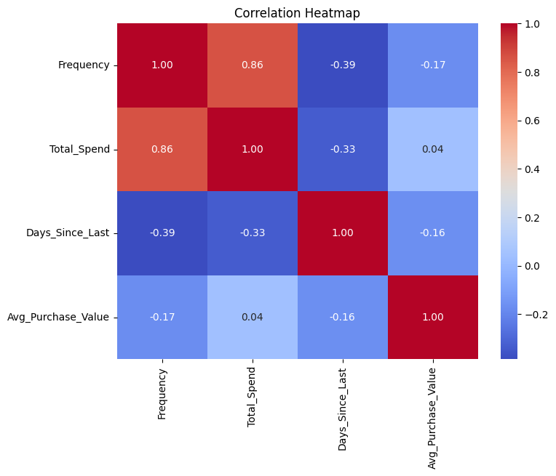
Part B - Correlation Analysis
Goal: Identify relationships between variables.
Interpretation:
  Strong positive correlation between Frequency and Total Spend.
  Negative correlation between Days Since Last Order and Spend (Churned customers spend less).
Notes:
Key Relationships1. Frequency ↔ Total_Spend (0.86) - Strong PositiveCustomers who order more frequently tend to spend more overallThis is the strongest relationship in your datasetMakes business sense: loyal, repeat customers = higher revenue2. Frequency ↔ Days_Since_Last (-0.39) - Moderate NegativeMore frequent buyers have purchased more recentlyNegative correlation means: as frequency increases, days since last order decreasesActive customers stay engaged3. Total_Spend ↔ Days_Since_Last (-0.33) - Moderate NegativeHigh-spending customers have purchased more recentlySimilar to above: valuable customers remain activeRisk indicator: customers with many days since last order are spending less4. Avg_Purchase_Value ↔ Other Metrics (Weak Correlations)vs Frequency (-0.17): Slight negative - frequent buyers may purchase smaller amounts per ordervs Total_Spend (0.04): Almost no correlation - surprising but indicates that total spend is driven by frequency, not order sizevs Days_Since_Last (-0.16): Weak negative - basket size doesn't strongly predict recency

Slide 7
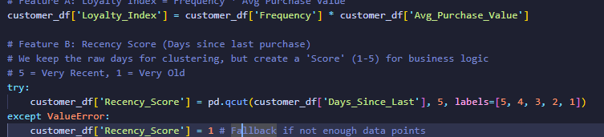
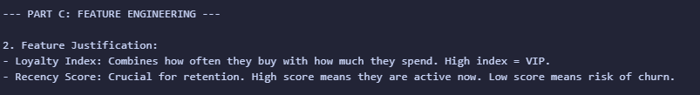
Part C - Feature Engineering
Derived Features:
  Loyalty Index: Calculated as Frequency × Avg_Purchase_Value. This highlights high-volume, high-value clients.
  Recency Score: Categorical score (1–5) derived from 'Days Since Last Purchase'.

Slide 8
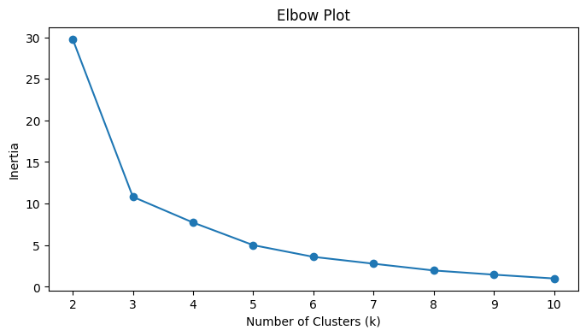
Part D - Clustering (Elbow Method)
Algorithm: K-Means Clustering.
Determining K: Tested k=2 to k=10 using Inertia.
Decision: Selected k = 4 because the "elbow" (rate of change) diminishes significantly at this point.
Notes:
Elbow Plot AnalysisThis graph helps determine the optimal number of clusters (k) for K-Means clustering of your customer data.What is Inertia?Inertia (Y-axis) measures the sum of squared distances between each data point and its assigned cluster center. Lower inertia = tighter, more cohesive clusters.Reading the GraphSteep Decline (k=2 to k=4):k=2: Inertia ≈ 30 (very high - customers forced into just 2 groups)k=3: Inertia ≈ 11 (sharp drop - much better separation)k=4: Inertia ≈ 8 (continued improvement)The "Elbow" Point:Occurs around k=3 or k=4This is where the curve starts to flatten significantlyAdding more clusters beyond this point yields diminishing returnsPlateau Phase (k=5 to k=10):k=5: Inertia ≈ 5k=7: Inertia ≈ 3k=10: Inertia ≈ 1The curve becomes nearly flat - minimal improvement despite adding complexityWhy Your Code Selected k=4From the code at line 176 in Nigerian_ecommerce1.ipynb, optimal_k = 4 was chosen because:Balance: Good cluster separation without over-segmentationInterpretability: 4 customer segments are manageable for business strategyDiminishing Returns: Beyond k=4, each additional cluster adds minimal valueBusiness ImplicationsWith k=4, you likely have customer segments like:High-value loyalists (frequent, recent, high spend)Regular customers (moderate on all metrics)At-risk customers (infrequent, not recent)New/occasional buyers (low frequency, varied spend)

Slide 9
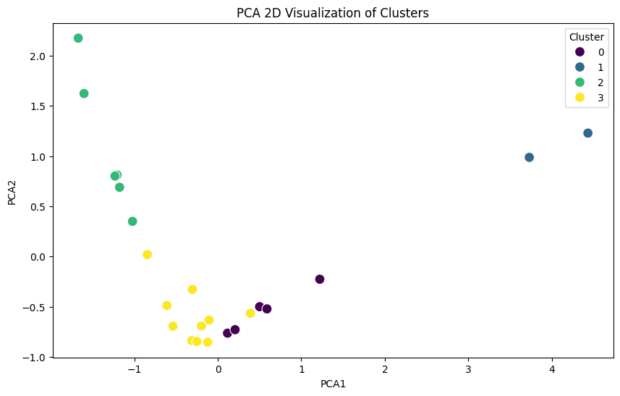
Part D - PCA Visualization
Technique: Principal Component Analysis (PCA) reduced dimensions to 2D for visualization.
Result: Distinct separation between groups confirms that K-Means successfully segmented the customers.
Notes:
PCA 2D Visualization of ClustersThis scatter plot shows your customer segmentation after dimensionality reduction using Principal Component Analysis (PCA).What is PCA?PCA takes your 3 clustering features (Days_Since_Last, Frequency, Loyalty_Index) and compresses them into 2 dimensions (PCA1 and PCA2) while preserving as much variance as possible. This allows visualization of multi-dimensional clusters on a 2D plot.The Four ClustersCluster 0 (Purple) - Moderate/Average CustomersLocation: Center of the plot (PCA1: 0 to 1.5, PCA2: -0.5 to -0.2)Characteristics: Likely average across all metricsCount: ~5 customersBusiness value: Standard customers requiring routine engagementCluster 1 (Teal/Blue) - High-Value VIPsLocation: Top-right and right side (PCA1: 3.5 to 4.5, PCA2: 1.0 to 1.25)Characteristics: High frequency, high loyalty index, recent activityCount: ~2 customersBusiness value: Your most valuable customers - require VIP treatment and retention focusCluster 2 (Green) - Engaged Regular CustomersLocation: Top-left quadrant (PCA1: -1.5 to -0.5, PCA2: 0.3 to 2.2)Characteristics: Good engagement, moderate-to-good loyaltyCount: ~6 customersBusiness value: Growth potential - could be upgraded to VIP statusCluster 3 (Yellow) - At-Risk/Low EngagementLocation: Bottom-center (PCA1: -0.8 to 0.3, PCA2: -0.9 to 0)Characteristics: Likely low frequency, high days since last order, lower loyaltyCount: ~10 customersBusiness value: Churn risk - needs re-engagement campaignsKey ObservationsClear Separation: Clusters are well-separated, validating your k=4 choice from the elbow plotSize Distribution: Cluster 3 (at-risk) is largest, suggesting many customers need attentionOutliers: Cluster 1 customers are far from others, confirming they're exceptional "whale" customersNatural Grouping: The spatial distribution shows natural customer segments rather than forced divisionsBusiness StrategyBased on this visualization from customer_df:Cluster 1: Retain at all costs (personalized service, exclusive offers)Cluster 2: Upsell opportunities (loyalty programs, volume incentives)Cluster 3: Win-back campaigns (discounts, re-engagement emails)Cluster 0: Standard marketing mix

Slide 10
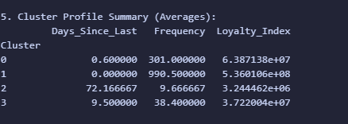
Part D - Cluster Profiling

Slide 11
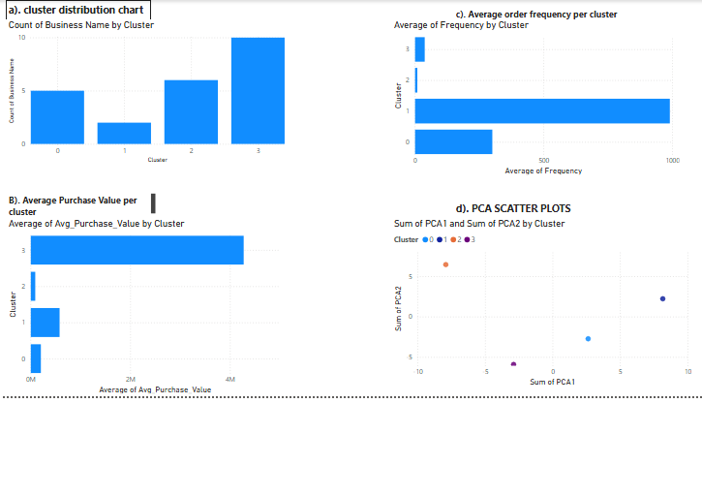
Part E - Power BI Dashboard
Dashboard Overview: Interactive tool for marketing team.

Slide 12
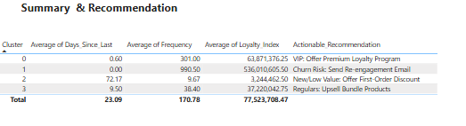
Part E - Recommendations
Actionable Insights:
Strategy:
  VIPs: Offer exclusive loyalty rewards.
  Churn Risk: Send "We Miss You" coupons.
  New Customers: Offer free shipping on next order.

